Slide 1


G2-5
Winter Wonders
Writing Project
Plan, write, publish your story in Build My Story
S1 • S2 • S3

Slide 2

Mini-Lesson
While you watch…
  What happens during winter?
  Think about winter sounds
  What do some animals do during winter?
Click For Video
S1 • S2 • S3

Slide 3
G2-5
Session 1
Brainstorm and Plan your story
S1

Slide 4
Learning Objectives
I can think of 3+ ideas and pick my best one.
I can sort my ideas in the boxes to make a plan.
I can listen to a partner and add one helpful suggestion.
S1

Slide 5
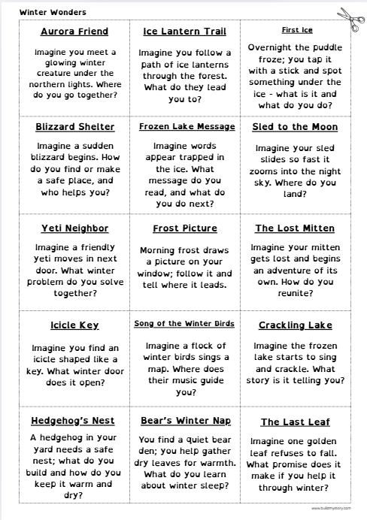
Choose a prompt
  Your teacher will hand out the Prompt Sheet
  Pick one idea or write your own
  Cut it out and glue on your Brainstorm sheet (or write your choice at the top)
  Keep it simple and clear
S1

Slide 6

Make your idea small and specific
• One moment, not the whole day
• One place, not lots of locations
• One problem to focus on
• If your idea is too big, zoom in!

Slide 7
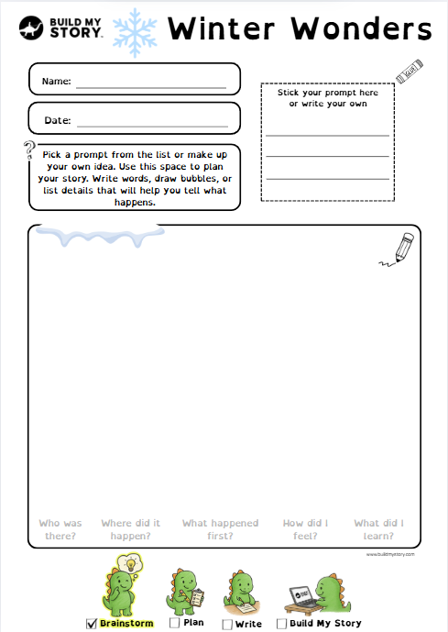
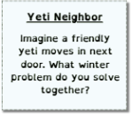

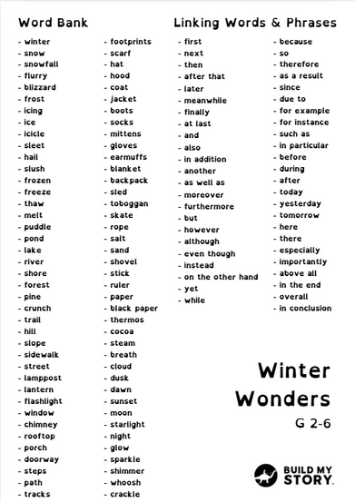
Brainstorm your ideas
You get 10 minutes
Use the word bank to help
  Use the Brainstorm sheet
  Words or quick sketches
  Use your senses
  Fill the page
S1

Slide 8



Turn to the person next to you and ask...
• Who is in your story?
• Where does it happen?
• When does it happen?
You get 2 minutes

Slide 9
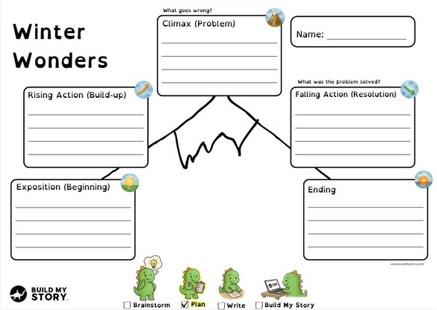





Story Mountain overview
You get 15 minutes
Climax:
Show the BIG problem or exciting event.
Rising Action:
Show what your characters are doing and build up to the problem.
Falling Action:
Show how the characters try to solve the problem and what happens next.
Exposition (Beginning):
Introduce your setting and characters
Ending:
Show how everything finishes and how the characters feel.
S1

Slide 10


Turn to the person next to you and ask...
• What is the BIG moment?
• How do things finish and how do they feel at the end?
You get 2 minutes

Slide 11

Build your main character
You get 10 minutes
  Name and age
  Are they Human, Animal or Fictional
  What colors are they wearing, do they wear glasses
  Looks and clothing
  One memorable detail
S1

Slide 12

Wrap Up & Next Time
Before you go – check
  Do you have a main character?
  Is there a beginning, middle and end?
  Is your name on every sheet?
Please hand in your amazing work so far!
Next time – your writing choices
  Summary → Help me write (bring 4–6 sentences)
  Full draft → Type it myself (aim for ≤ 200 words)
S1

Slide 13

Learning Objectives
I can think of 3+ ideas and pick my best one.
I can sort my ideas in the boxes to make a plan.
I can listen to a partner and add one helpful suggestion.
S1

Slide 14
G2-5
Session 2
Write Your Story
S1

Slide 15
Learning Objectives
I can turn my plan into a draft.
I can use words like first / next / because to connect ideas.
I can add a detail so my writing is clearer.
S1

Slide 16
The 5-part story frame
1
4
Falling Action:
Show how the character tries to solve the problem and what happens next.
Exposition (Beginning):
Introduce your setting and characters
2
Rising Action:
Show what your character is doing and build up to the problem.
5
Ending:
Show how everything finishes and how the character feels.
3
Climax:
Show the BIG problem or exciting event.
S2

Slide 17


Choose your path
Either path is great — pick the one that helps you do your best
PATH A
PATH B
OR
Story Summary
(4–6 sentences)
Full Draft
(About 500 words)
Only as much as you can do
S2

Slide 18
Path A: Story Summary — 4–6 sentences
1) Who + where (Exposition)
2) Want + problem (Rising Action)
3) BIG moment (Climax)
4) What they try / what happens next (Falling Action)
5) How it ends + feeling (Ending)
S2

Slide 19
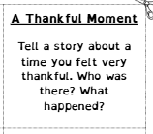
Example Story Summary 1
1) On Thanksgiving at Grandma Rosa’s house, I was with my parents and little brother.
2) We wanted a cozy dinner, but a storm cut the power and the turkey was raw.
3) The big moment came when our neighbor, Mrs. Lee, arrived with hot rice and a lantern.
4) We grilled the turkey outside, shared food, and told stories by the glow.
5) Dinner worked after all, and I felt thankful for our neighbors and my family.
S2

Slide 20
Example Story Summary 2
1) On Thanksgiving morning at the community center, my class packed food boxes.
2) I wanted to help everyone, but we ran out of cans and families were still waiting.
3) The big moment came when my grandpa arrived with extra bags from our neighbors.
4) We filled every box, added kind notes, and carried them to the cars.
5) People smiled and said thank you, and I felt proud and thankful for Grandpa and our town.
S2

Slide 21
Path B: Full Draft - About 500 words
• Around 500 words total - do as much or as little as you can!
• Short sentences
• Use this order:
Beginning → Build-up → BIG moment → Fixing it → Ending + feeling
S2

Slide 22
Write on the worksheet page by page. Think about the Story Mountain and follow the icons.
Draft guide
• Beginning — 2–3 lines
• Build-up — 3–5 lines
• BIG moment — 2–3 lines
• Fixing it — 3–4 lines
• Ending + feeling — 2–3 lines
S2

Slide 23
Show, don’t tell
Tell → I was happy.
Show → I grinned and bounced in my chair.
Tell → It smelled good.
Show → Butter popped and cinnamon filled the kitchen.
Swap one “tell” for a “show.”
S2

Slide 24
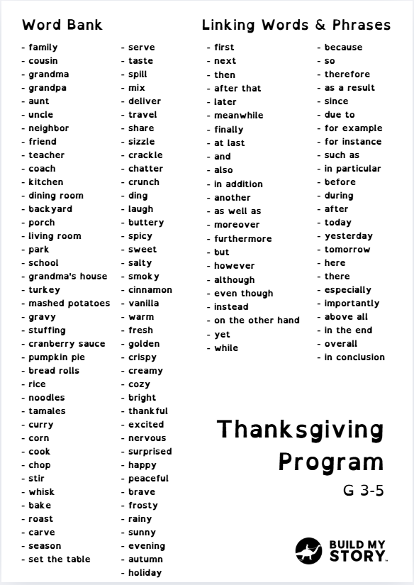

Write Time!
You get 20 minutes
Summary path: finish 5 sentences.
Draft path: aim for 300-500 words.
Tip: Use 2–3 linking words.
Use the word bank to help
S2

Slide 25
Swap your worksheet with the person next to you
3 quick checks (circle or say Yes/No)
1) Does it follow the 5 parts? Beginning → Build-up → BIG moment → Fixing it → Ending
2) Are there 2–3 linking words? (first, next, then, after that, because, so, finally…)
3) Is there one “show, don’t tell” sentence?
Fix one thing, then put your name on your work.
You get 2 minutes

Slide 26
Learning Objectives
I can turn my plan into a draft.
I can use words like first / next / because to connect ideas.
I can add a detail so my writing is clearer.
S1

Slide 27
G2-5
Session 3
Build Your Story
S3

Slide 28
Learning Objectives
I can revise my draft story to make it clearer
I can fix capitals, punctuation, and spelling.
I can type my story and give it a great title.
I can publish a book!
I can make an AI picture
S1

Slide 29



Sign in
1
2
3
  Open Build My Story
  Tap Kid to sign in
  Log in using username
Your teacher will help with usernames or Clever or Google Classroom
S3

Slide 30

Set up your book
1
2
  Type your main character’s name
  Choose your reading level (ask if unsure)
3
  Pick your picture style
4
  Click Continue
S3

Slide 31


Choose how to write
Path A
Path B
Help me write — paste your summary
Type it myself — type your story
S3

Slide 32
Help me write — paste your summary
1
  Paste your 4–6 sentence summary
4
  Choose Language
2
  Choose Story Type
5
3
  Choose Writing Style
  Click Continue
S3

Slide 33
Type it myself
  Type into the 11 pages
1
Remember:
Beginning → Build-up → BIG moment → Fixing it → Ending
Use 2–3 linking words
2
  Click Continue
S3

Slide 34



Build your character
  OR
  Upload a drawing
  OR
  Click ‘Continue without uploading character’
  A picture of a character
S3

Slide 35

Build your character
Choose Character Type:
  Human, Animal or Fictional
1
  Age or character type if its an animal or fictional
2
3
  Type character appearance.
4
  Click ‘Generate New Character’
What does the character look like?
S3

Slide 36


Build your character
  Click to view all of the characters you have made
S3

Slide 37

Edit Your Book Until You Are Happy!
  Edit Your Title
  Edit Author Name
  Scroll and Read your amazing story!
S3

Slide 38


How to edit text
  Click ‘Edit Text’
  Type, Edit and ‘Update Text’
S3

Slide 39

How to edit Images
  Click ‘Edit Image’
  Type in your Image Prompt
What is an image prompt? →
S3

Slide 40
What is a good image prompt?
  What’s a prompt?
It’s the sentence that tells the app what to draw on this page.
  Your main character stays the same—you change the action, place, and details.
  The 4 Magic Parts (A-P-O-M)
  Action – what is the character doing?
  Place – where is it happening?
  Objects – 1–2 things to include (props).
  Mood/Time – how it feels (cozy, windy) or when (evening, rainy).
S3

Slide 41
Quick Example Image Prompts
  Good Prompt
“The character stirs a big pot in Grandma’s kitchen at sunset; steam rises and a pumpkin pie cools on the counter.”
  Not Good Prompt
“The character in the kitchen.”
  Why is this not a good prompt? Put your hand up
Remember The 4 Magic Parts (A-P-O-M)
Action + Place + Objects + Mood/Time
S3

Slide 42


Why is this a bad prompt?
  Not Good Prompt
“The character in the kitchen.”
Action – No Action
Place – “The kitchen”
Objects – No Objects
Mood/Time – No Mood/Time
The bad prompt has not passed the 4 magic parts!
S3

Slide 43

Why is this a good prompt?
  Good Prompt
“The character stirs a big pot in Grandma’s kitchen at sunset; steam rises and a pumpkin pie cools on the counter.”
Action – “Stirs a...”
Place – “Grandma’s kitchen”
Objects – “Big Pot”, “Pumpkin Pie”
Mood/Time – “Sunset”
The good prompt has passed the 4 magic parts!
And that’s how to use AI!
S3

Slide 44



You can even add more characters!
1
2
3
  Click ‘Select New Character’
  Create or choose a new character
  Edit Image Prompt
Remember to change your image prompt with your new character!
S3

Slide 45



Proof Read when you’re finished!
  Click on the
S3

Slide 46
Learning Objectives
I can revise my draft story to make it clearer
I can fix capitals, punctuation, and spelling.
I can type my story and give it a great title.
I can publish a book!
I can make an AI picture
S1

Slide 47
G2-5
What is AI?
Optional Add On
S3

Slide 48



The first question is...
What is A.I?
S3

Slide 49






What is A.I?
AI = Artificial Intelligence.
  • It means computers learn patterns from lots of examples.
  • Then they use those patterns to help us: recognize voices, suggest words, translate, draw pictures from words, and chat.
That’s how your character was made!
S3

Slide 50
  In Build My Story, AI can:
– grow your summary into a story (Help me write)
  – make pictures from your prompt (Create new image)
  Remember!
AI is NOT a person. It has no feelings and can make mistakes.
  YOU are the author — check, edit, and choose what to keep.
  Story Summary → Big Story
Be smart & kind online:
• Don’t share private info (full name, address, passwords).
• Ask an adult if something doesn’t look right.
  Image Prompt →
S3

